Slide 1


Titolo presentazione sottotitolo
Localization, Navaigation and Smart Mobility
Project activity 2019/2020
Carminati Fabio, mat. 919803
Gallone Emanuele, mat. 914114
Milano, XX mese 20XX

Slide 2
Introduction
With the competences acquired during the Localization Navigation and Smart Mobility course we will now propose and discuss the solutions for the tasks 1,2,3,4,5,6 through the use of Matlab code.
It is possible to fetch both the Matlab Figure as well as the performances matrixes from which the graphs that will be shown are taken
Tic and Toc matlab functions have been used for evaluating the execution time of the various tasks

Slide 3
Assumptions
Scenario area: 2D location area of 4000*4000 m where the x-axis range is
[-2000 2000] while the y-axis range is [-2000 2000]
Only one user at each time in the simulated scenario
The number of APs and their location is computed at task 1 and assumed to be constant for all the following tasks
The R matrix is computed at task 2 and assumed to be constant for all the following tasks
In the Matlab code there are switches that enables a custom run of the code (i.e. decide each time which tasks to run)
Since tasks 1,2 are mandatory for the tasks 3,4,5,6 their switches refer just to the plot of the results
The code is organized in functions in order to improve its readability

Slide 4
Task 1
Task 2
Task 3
Task 4
Task 5
Task 6

Slide 5
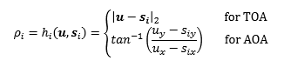
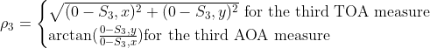
Task1a:Learn the position of the APs
Reference point in u=[0 0]
Since there is no noise in the given TOA and AOA measurements we will obtain exactly the true APs location
Solution algorithm: insert into the following system the TOA and AOA measurements of the various APs using as u coordinates the reference point
For the third Access Point the formula becomes:

Slide 6
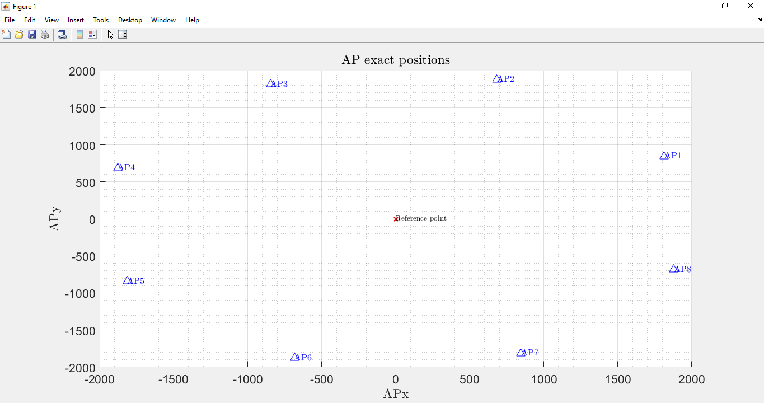
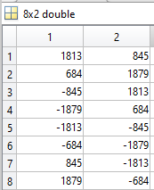
Task1a:Results
LNSM_Project\Performances_and_results\Task1

Slide 7
Task1b:Covariance Matrix of TOA measurements
Reference point is now u=[500 -800]
R matrix is computed using:
The given 5000 rho measurements for each of the APs ( i.e. )
The exact location of the APs found at task 1a (i.e. we can compute h(u) using the Euclidean distance)
Since for each AP we need to:
Obtain 5000 n values and compute their covariances
Round these covariances values and place them into a diagonal matrix: we have now computed R

Slide 8
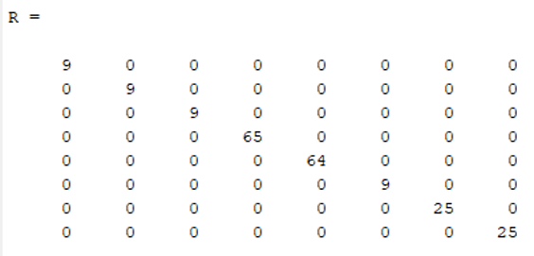
Task1b-Results
LNSM_Project\Performances_and_results\Task1\R_matrix.mat

Slide 9
Task 1
Task 2
Task 3
Task 4
Task 5
Task 6

Slide 10
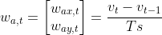
Task2:Learning the motion model dataset for motion models
After an analysis of the given trajectories dataset we realize that they refer to a M3-Random Force motion model since:
User coordinates (U_{x},U_{y}) and velocity(V_{x},V_{y}) are given
V_{x},V_{y} have a not zero mean
There is a random acceleration process w_{a,t} that resembles a gaussian distribution with almost zero mean and variance different from 0
As regards the w_{a,t} :
Compute w_{a,t} as: for all 100 trajectories
Compute the mean and variance of the overall w_{a,t}

Slide 11
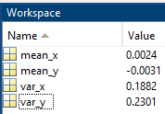
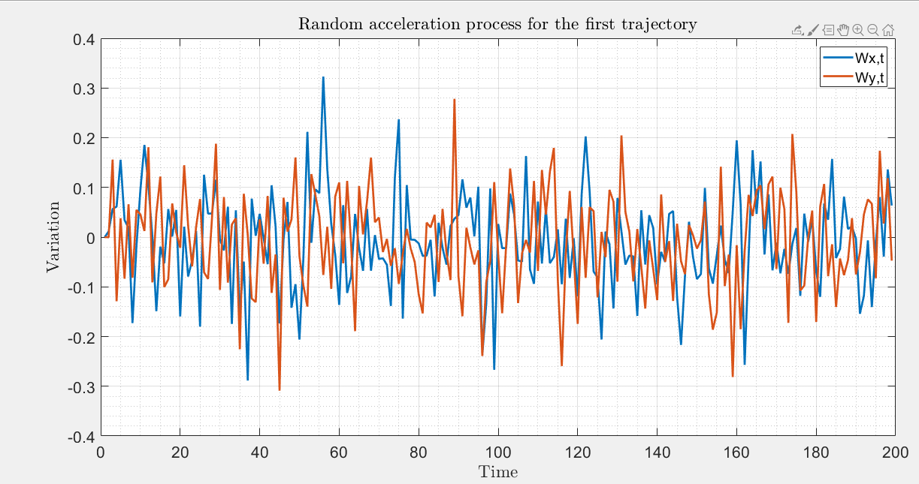
Task2:Results
LNSM_Project\Performances_and_results\Task2

Slide 12
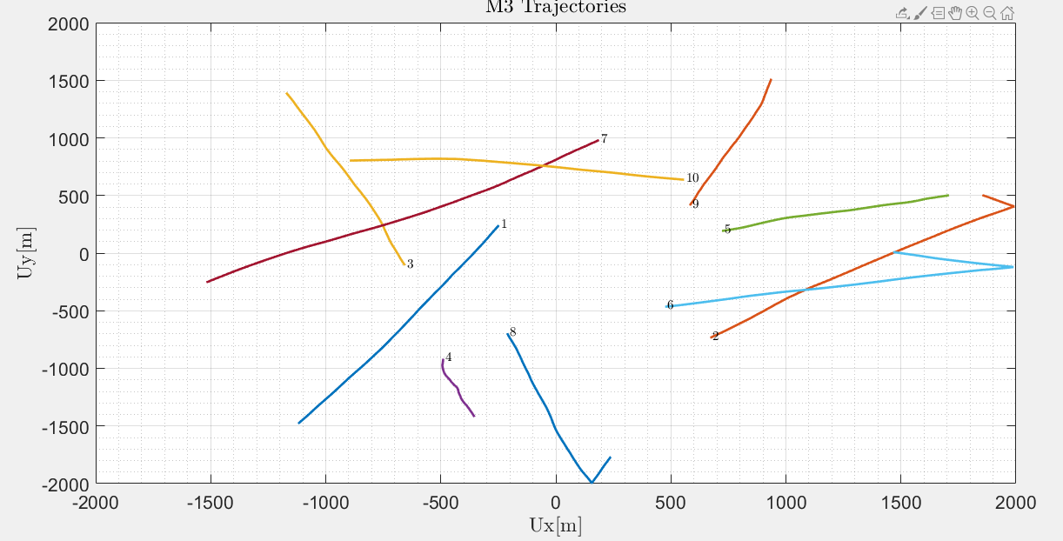
Task2:Plot the first 10 trajectories that refers to an M3 model
LNSM_Project\Performances_and_results\Task2

Slide 13
Task 1
Task 2
Task 3
Task 4
Task 5
Task 6

Slide 14
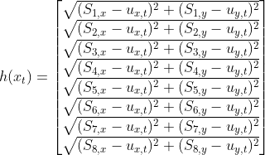
Task3:Kalman filter testing on known trajectory
Since we have TOA measurements the expression is:
It is immediately clear that is not linear thus we need to use an Extended Kalman Filter(EKF).
For the details about how the EKF is implemented we suggest a code inspection.
In order to be able to perform both the Prediction and the Update step we need to do some precomputation.

Slide 15
Task3:Precomputation and assumptions
From the M3 motion model we fetch :
F = [eye(2) , Ts*eye(2);
zeros(2,2) , eye(2)];
L = [0.5*Ts^2*eye(2);Ts*eye(2)];
v(:,1) = [7;2];
x = [zeros(2,TotalSimulationTime);v];
x(:,t) = F*x(:,t-1) + L*w;
Q=sigma_squared_a*(L*L’);
F,Q are assumed to be time invariant
P is initialized with an eye(4);
X is initialized with the first point of the trajectory
For the performance evaluations we compute and store the C matrix, sigma_h (drms) and CEP95 values for all the elements of a trajectory

Slide 16
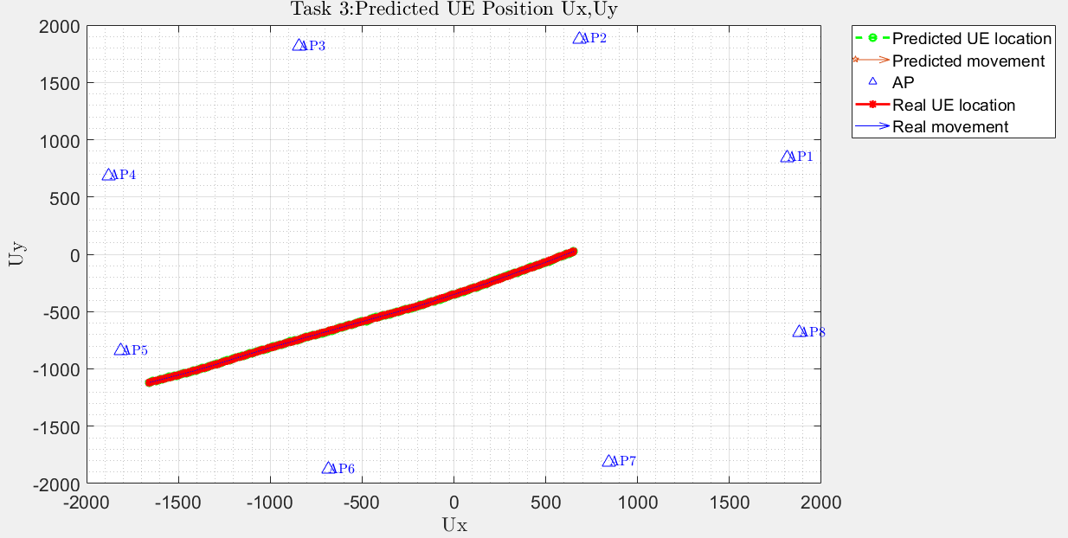
Task 3:trajectory #35
LNSM_Project\Plots\Task3

Slide 17
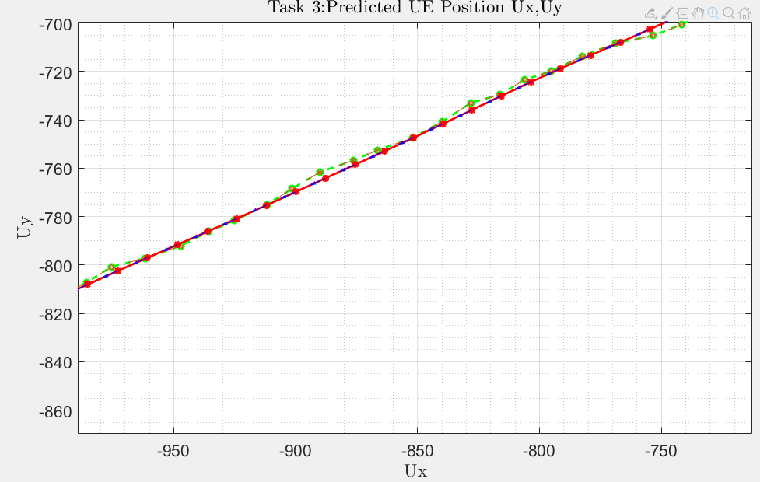
Task 3:trajectory #35 Details

Slide 18
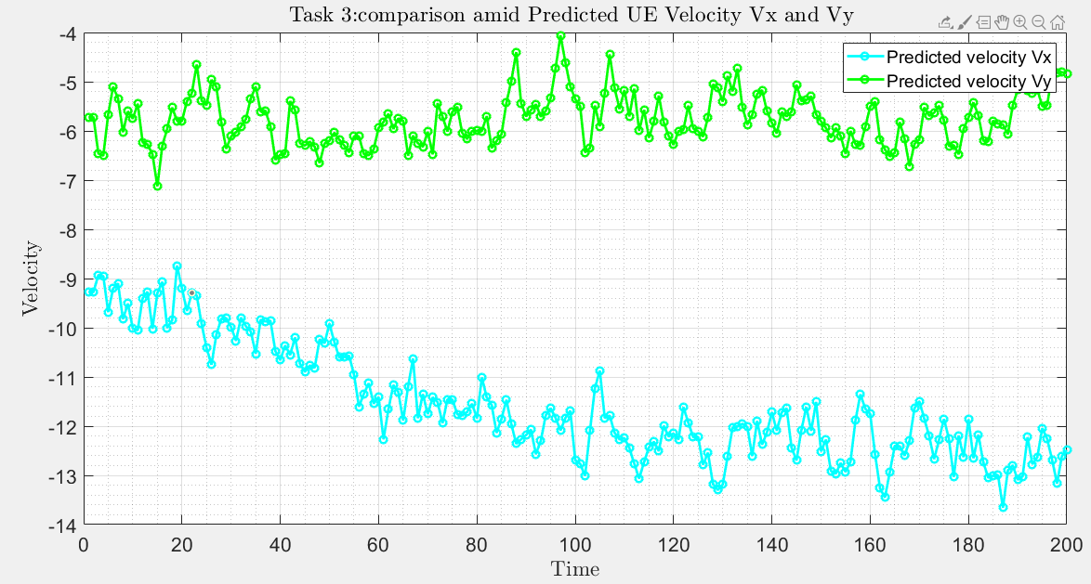
Task3:trajectory #35

Slide 19
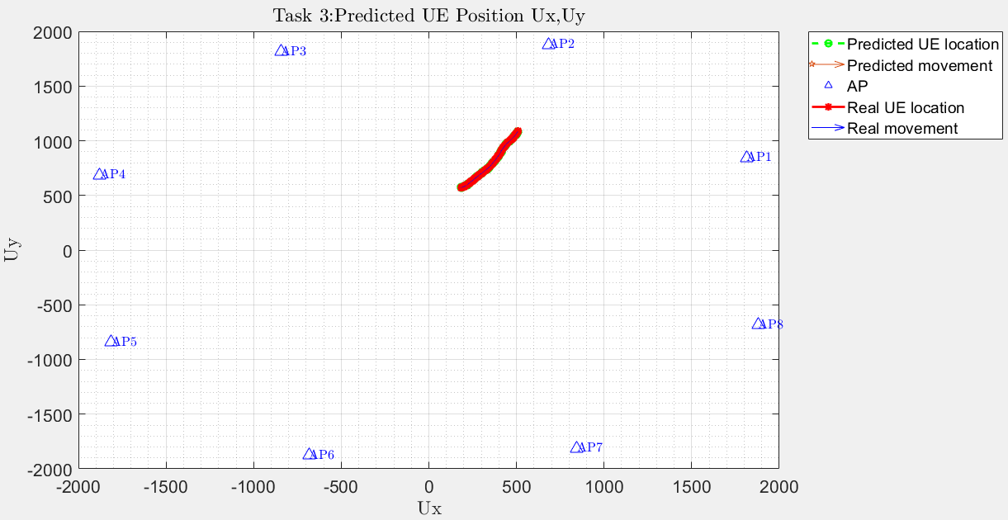
Task 3:trajectory #72
LNSM_Project\Plots\Task3

Slide 20
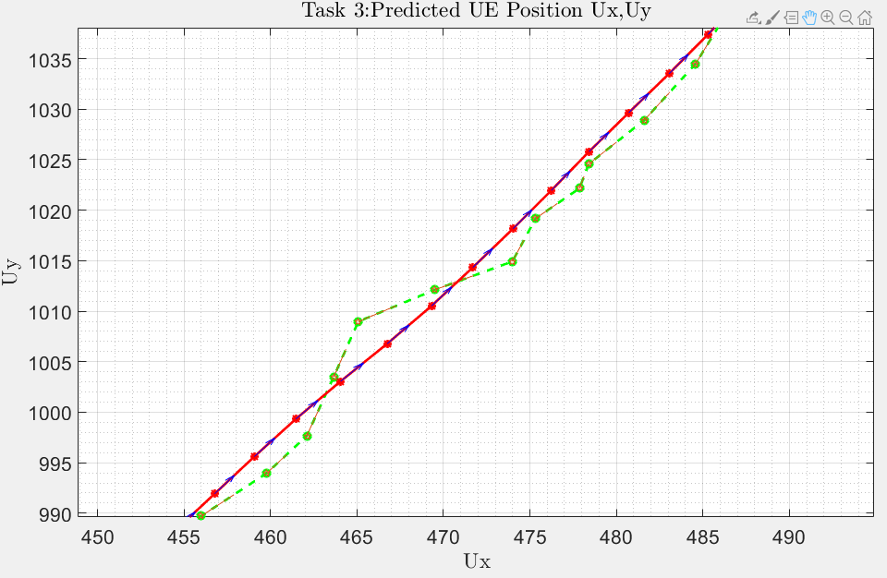
Task 3:trajectory #72 Details

Slide 21
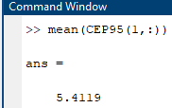
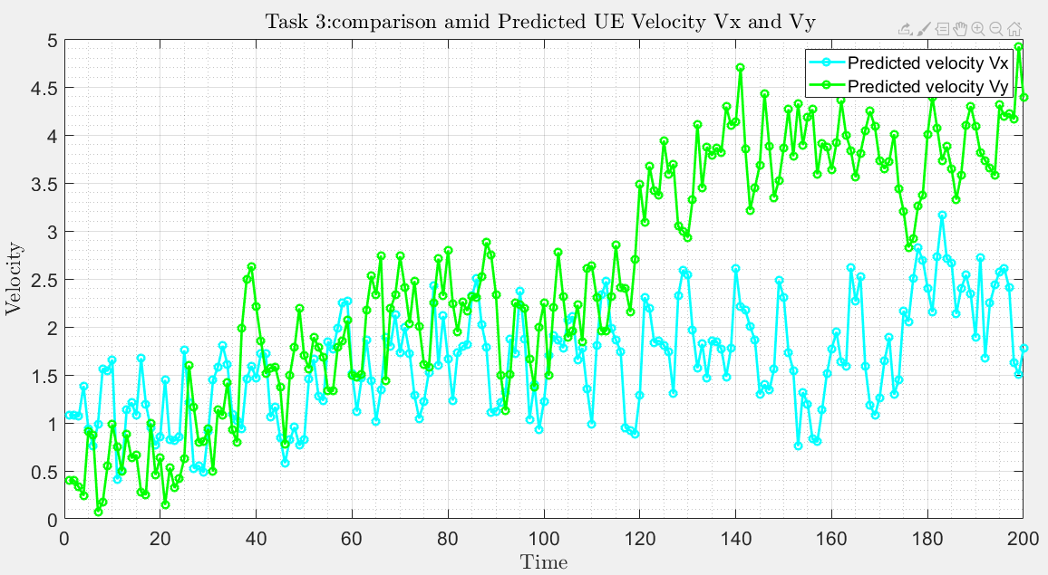
Task 3:trajectory #72

Slide 22
Task 1
Task 2
Task 3
Task 4
Task 5
Task 6

Slide 23
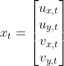
Task4: Kalman filter testing on unknown trajectory
W.r.t. task 3 we don’t have a priori knowledge of the user trajectory; thus we need to build at each step:
The estimation of the user location (U_{x},U_{y}) is done step by step through iterative NLS algorithm
As regards the velocities (V_{x},V_{y}):
For the first element: V_{x}=50 km/h (13.88 m/s) as the text says while V_{y}=0 m/s since nothing is said
(V_{x},V_{y}) both equal to 0 m/s for the following steps since nothing is said
In order to evaluate whether our iterative NLS implementation was correct or not we test it over a known trajectory (trajectory # 5 of task 2). From that experimental try we found that iterative NLS provides an adequate estimation after 4 iterations.
We expect that a degradation of the accuracy metrics w.r.t. task 3 where the user trajectory was known

Slide 24
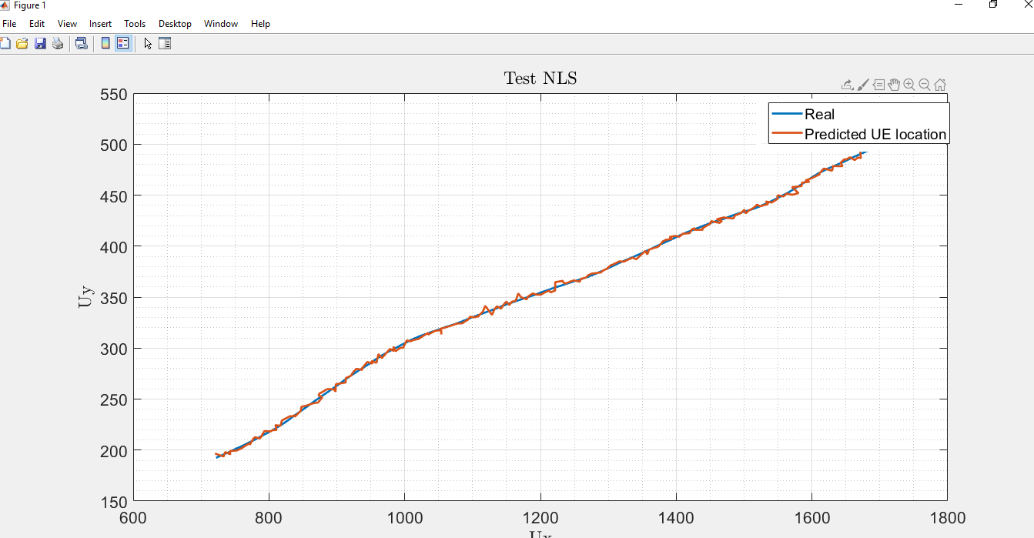
Task 4: Iterative NLS evaluation

Slide 25
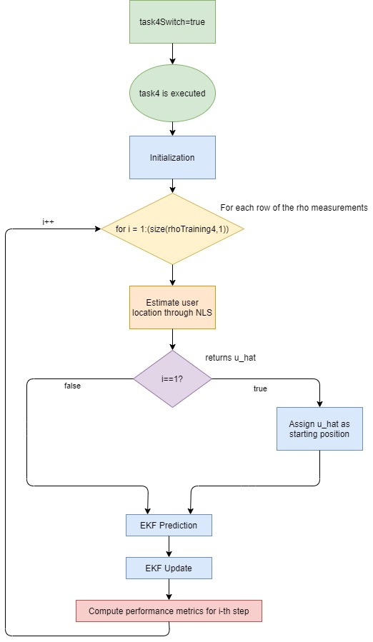
The algorithm for
task 4 resolution is:

Slide 26
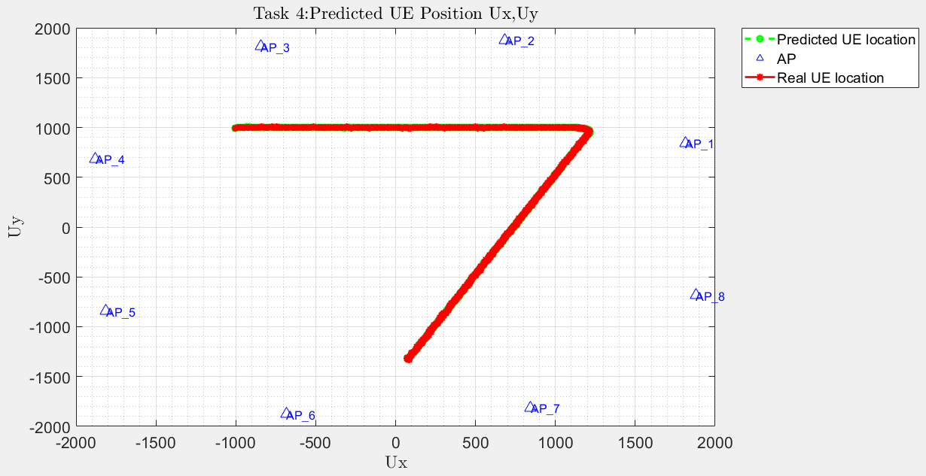
Task4: Trajectory
LNSM_Project\Plots\Task4
A small note: Real UE location refers to the one calculated through iterative NLS

Slide 27
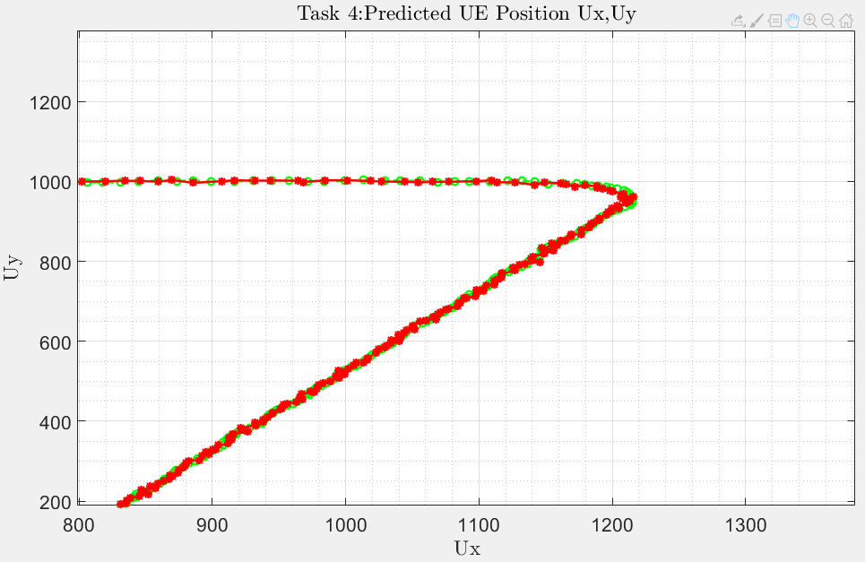
Task4: Trajectory details

Slide 28
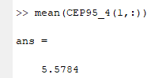
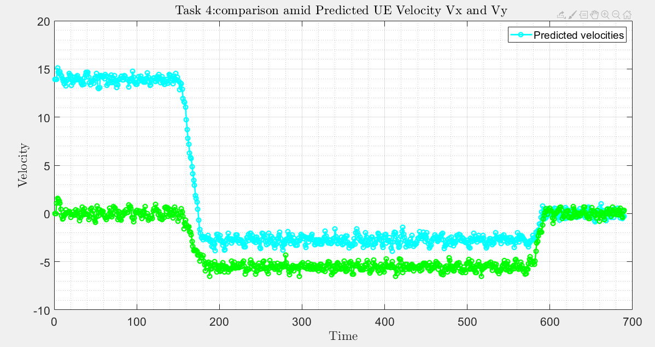
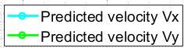
Task4: Velocities

Slide 29
Task 1
Task 2
Task 3
Task 4
Task 5
Task 6

Slide 30
Task 5: Kalman filter testing on unknown trajectory

Slide 31
Task 1
Task 2
Task 3
Task 4
Task 5
Task 6

Slide 33
Model-Components(1)
Access Point:
One server
Finite Queue with capacity 80(customer + service)
Queue Policy: FCFS with dropping
Routing: p=0.1 to the wagon route; p=0.6 to the external network; p=0.3 to the railway server
Service time: exp(1) for both classes of passengers given that no computation is performed but we just filter the incoming packets
Wagon Server:
One server
Stores the media content
Infinite queue capacity
Queue Policy: PS because acts like a server(does computation)
Routing: p=1 to the railway server.
Service time: exp(1)

Slide 34
Model-Components(2)
Cloud:
100 servers
Infinite queue capacity
Queue policy: PS because acts like a server(does computation)
Routing: p = 0.12 to the Staff Delay, p = 0.88 to the Sensor Delay
Service time: exp(2) for the staff, exp(8) per sensors

Slide 35
Model-Components(3)
Railway Server:
Infinite queue capacity
One server
Queue policy: PS because acts like a server(does computation)
Routing: p=1 to the Edge for the two open model passenger classes, p=0.88 to the Sensor Delay, p=0.12 to the Staff Delay
Service time: exp(2) for the staff, exp(8) per sensors
Sensor Delay
Reference station for the closed model class Sensors
Think time=0.1s(deterministic)
N=63
Staff Delay
Reference station for the closed model class Staff
Think time=60s(deterministic)
N=8

Slide 36
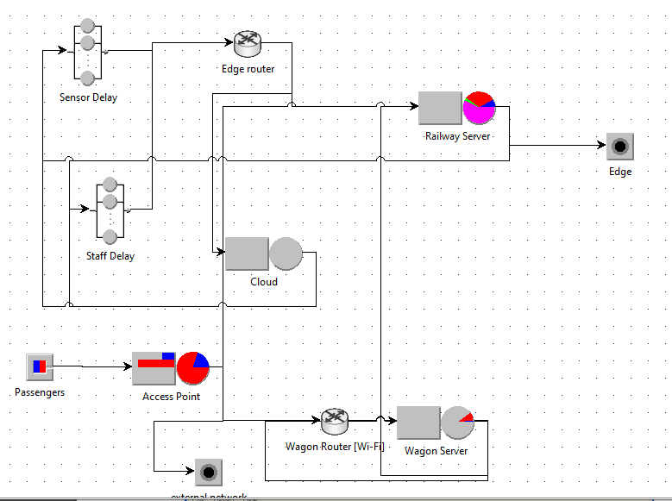
Simulation
CLASS 1
CLASS 2
STAFF
SENSORS

Slide 37
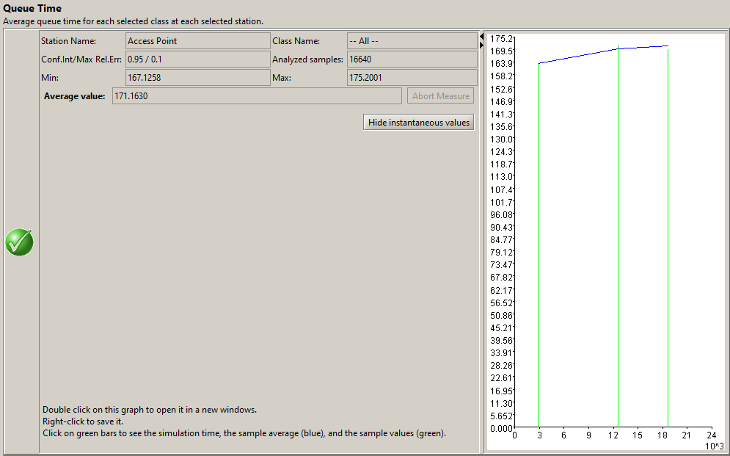
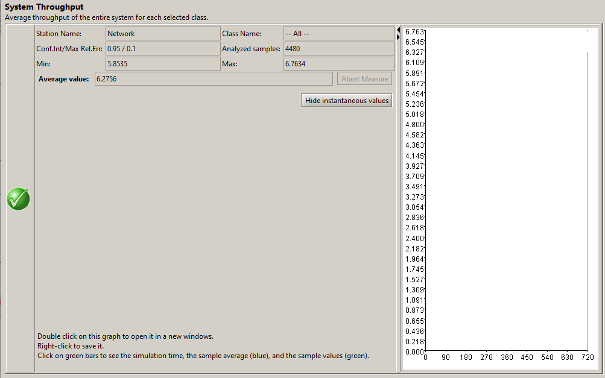
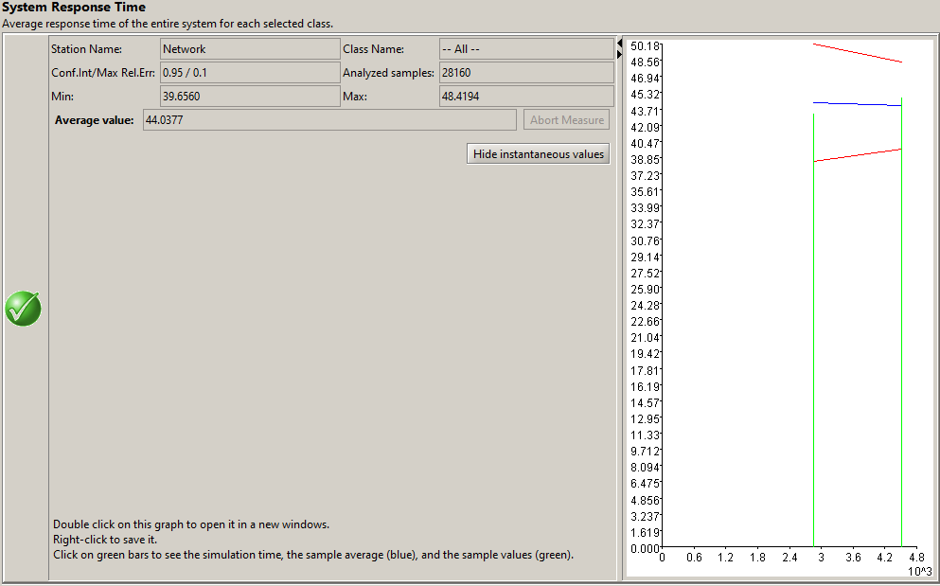
Simulation(1)
Whole System:
Queue Time = 171.16 ms
Response Time= 44.03 ms
Throughput = 6.27 req/ms
= 6270 req/s

Slide 38
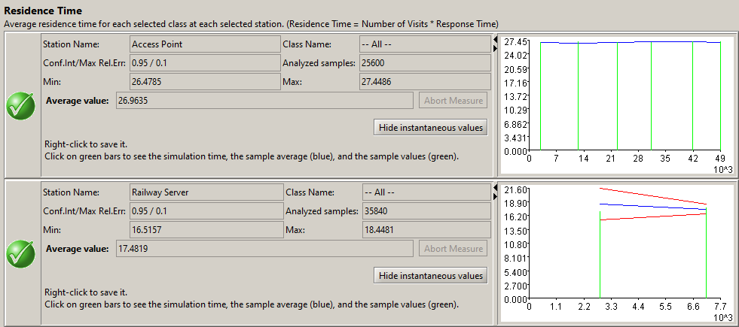
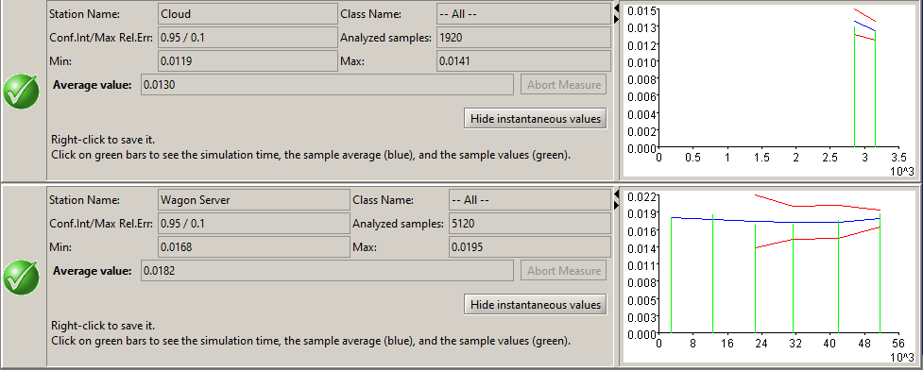
Simulation(2)
Residence Time:
AP = 26.96 ms
Railway Server = 17.48 ms
Cloud = 0.013 ms
Wagon Server = 0.018 ms

Slide 39
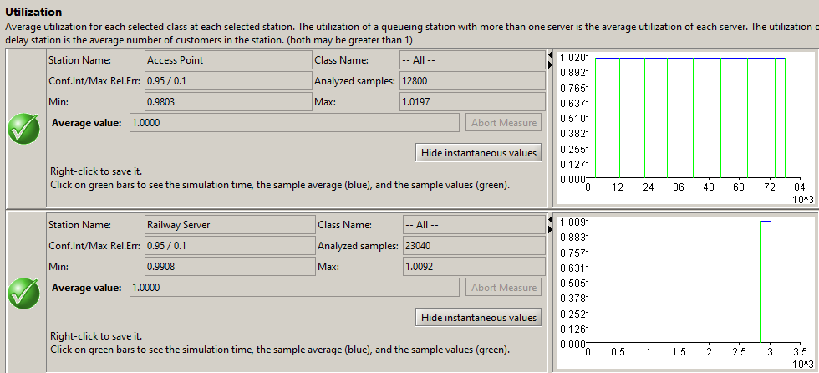
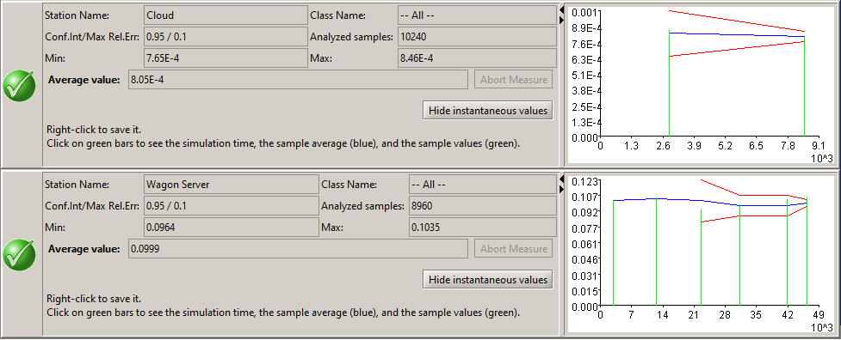
Simulation(3)
Utilization:
AP = 1
Railway Server = 1
Cloud = 0.000805
Wagon Server = 0.099
Having an utilization =1 results in an unstable system indeed the queueing time of the system keeps growing

Slide 40
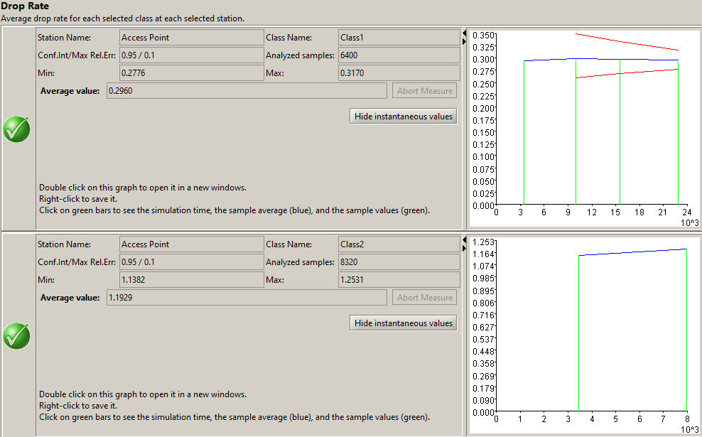
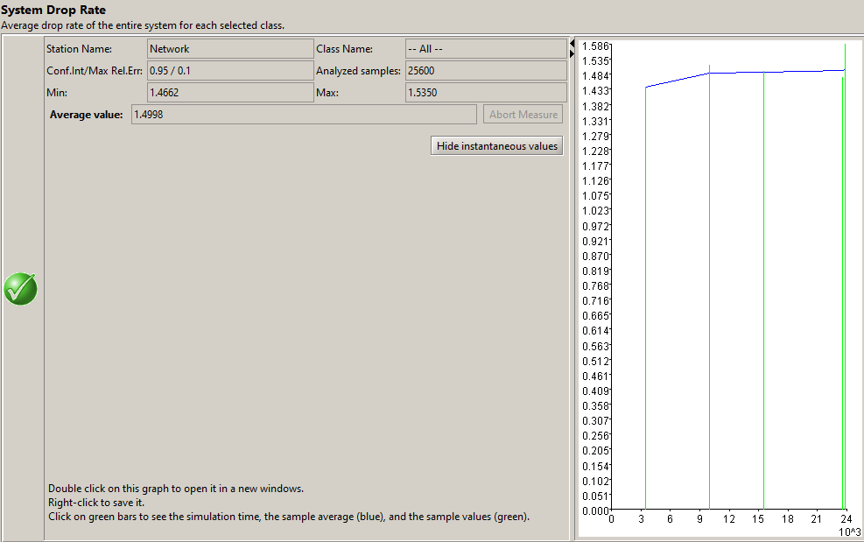
Simulation(4)
System drop rate = 1.412 req/ms
Class 1 drop rate = 0.296 req/ms
Class 2 drop rate = 1.192 req/ms

Slide 41
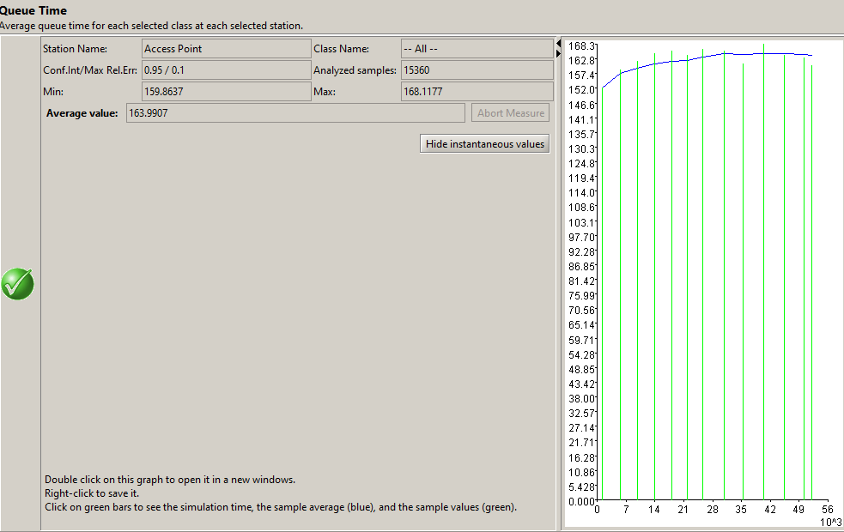
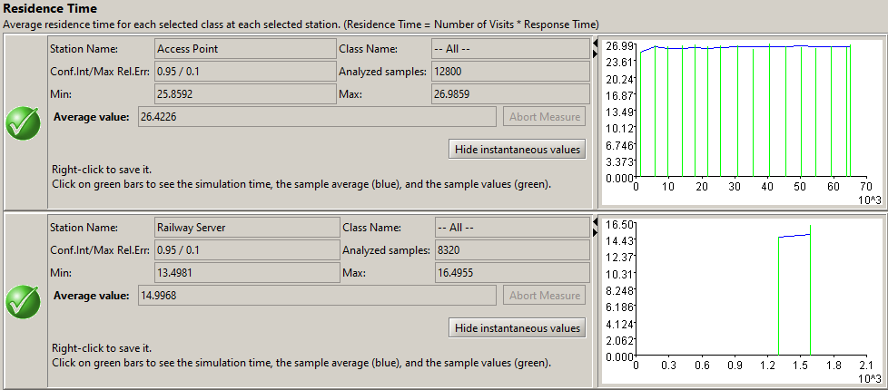
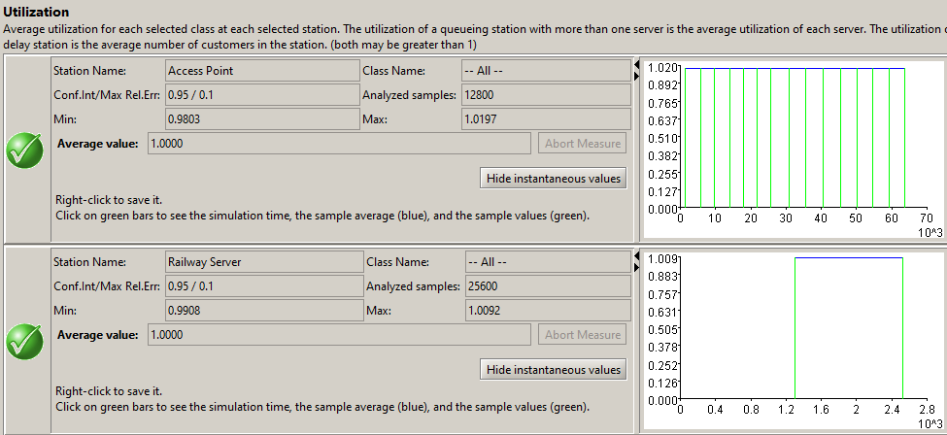
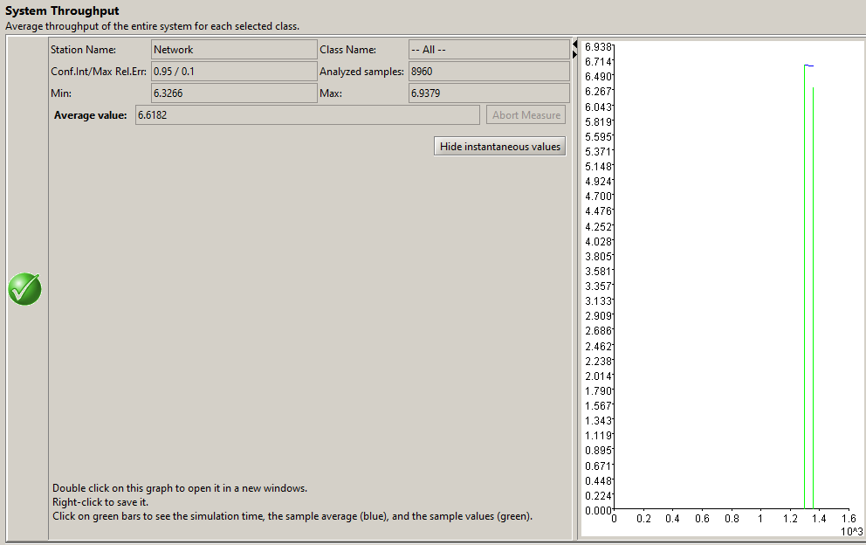
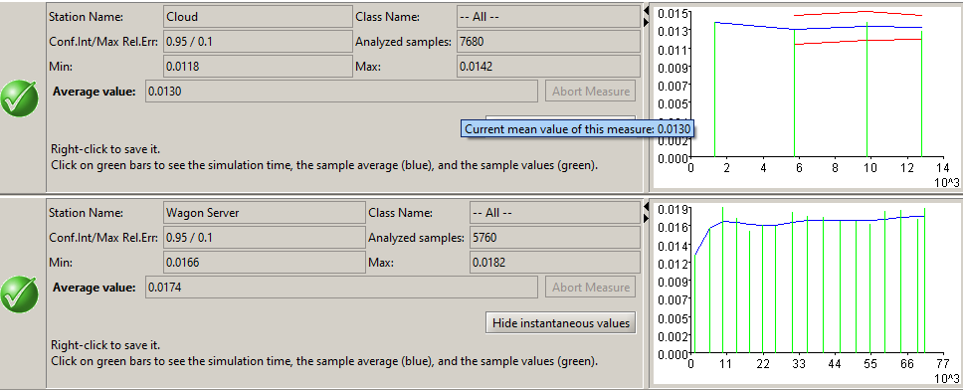
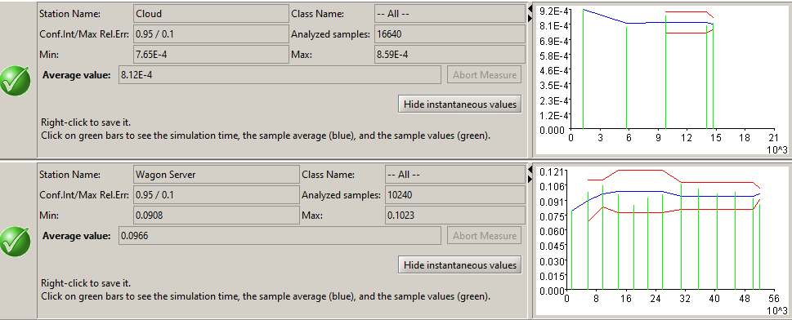
Simulation(5)
Then we’ve simulated a «burst» condition assuming a very heavy class 2 load (class 2 mean times 100) interval very low load (class 2 mean divided 100)
In this condition the system responds in a similar way: we’ve found no significant variation in queue time, utilization, residence time and throughput. Anyway...

Slide 42
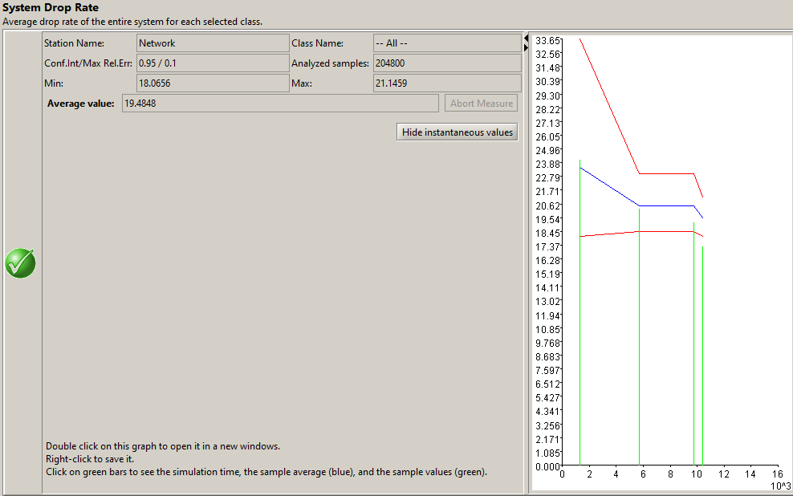
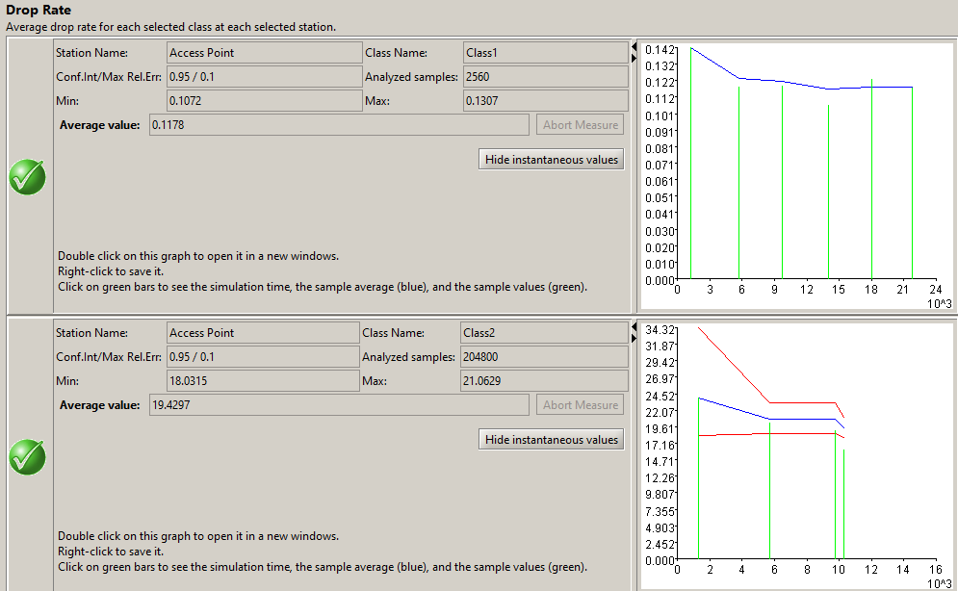
Simulation(6)
... The drop rate increases dramatically up to 19.48 req/ms from 1.412 req/ms of the standard model.
Class 1 drop rate = 0.117 req/ms
Class 2 drop rate = 19.429 req/ms

Slide 43
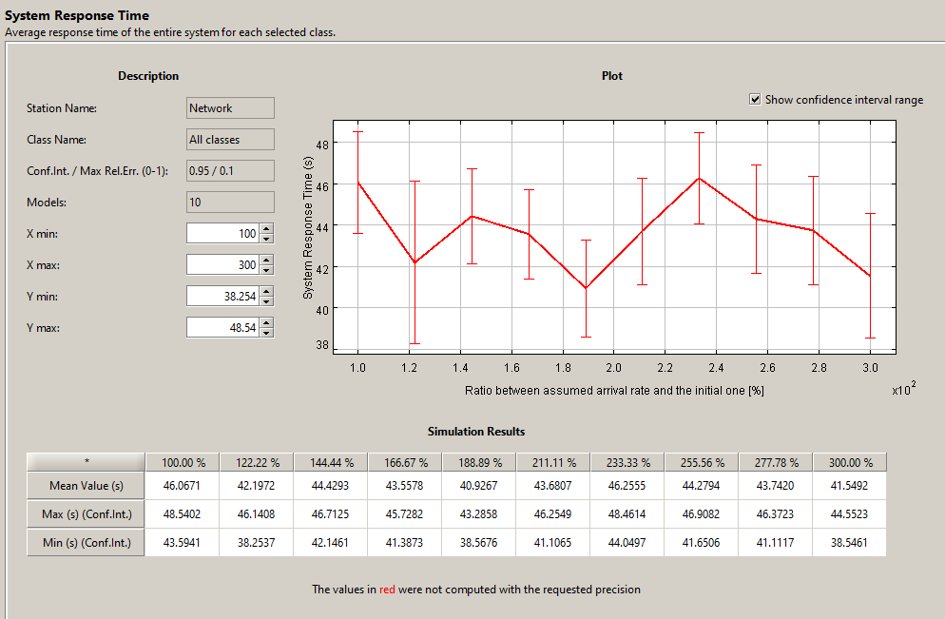
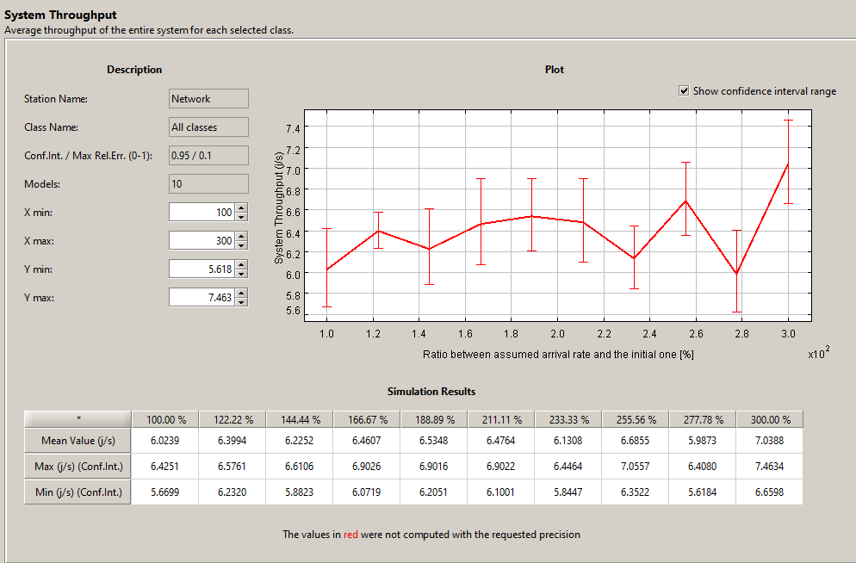
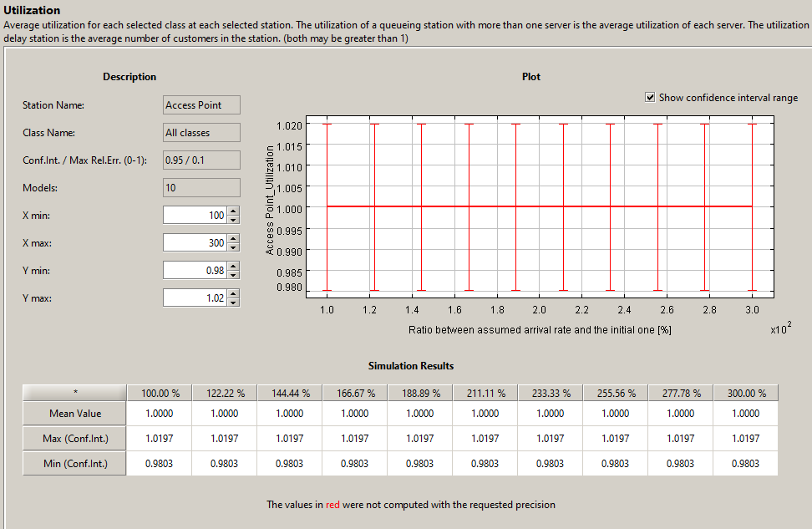
What-If Simulation (Arrival rates 1)
Passengers open model arrival rates is incremented from 100% to 300% in 10 steps

Slide 44

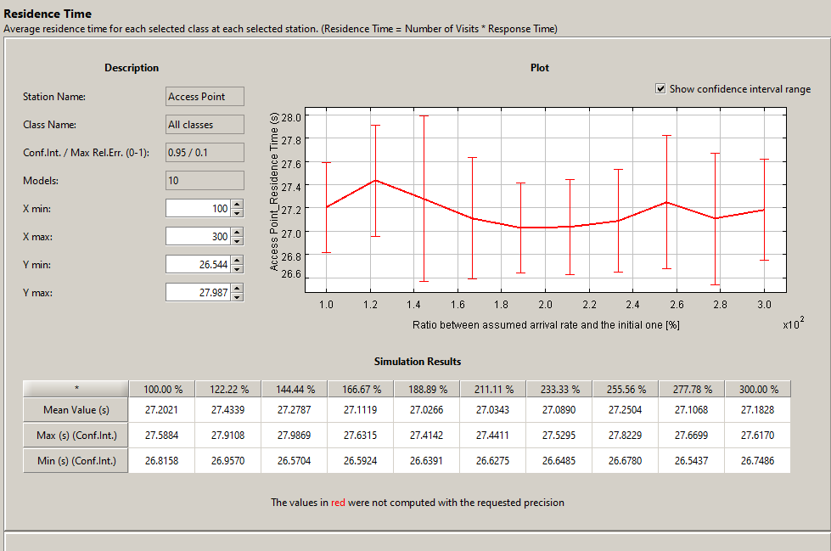
What-If Simulation (Arrival rates 2)
Results:
Utilization is constant
System response time = -8.69% (from 46 ms to 42 ms)
Throughput = +14.18% (from ~6.05 to ~7.05 [req/ms])
Queue Time = +0.26%
Residence Time ~= constant

Slide 45
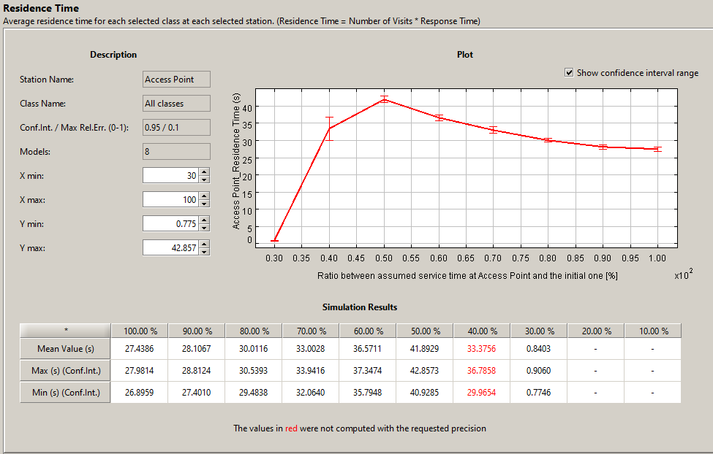
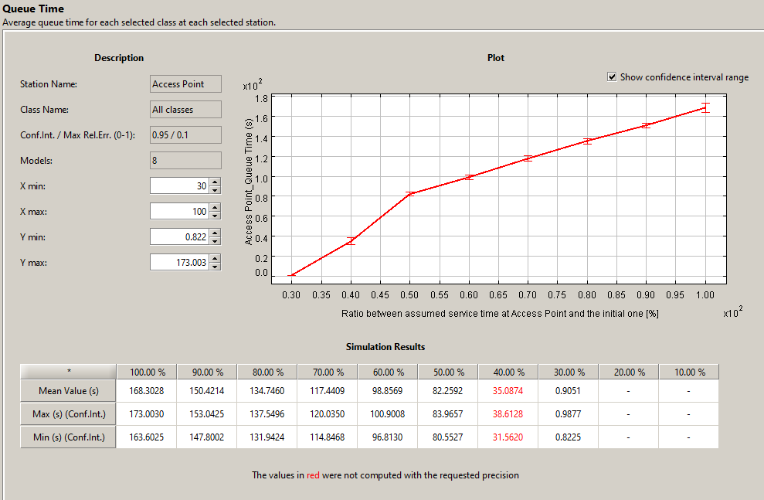
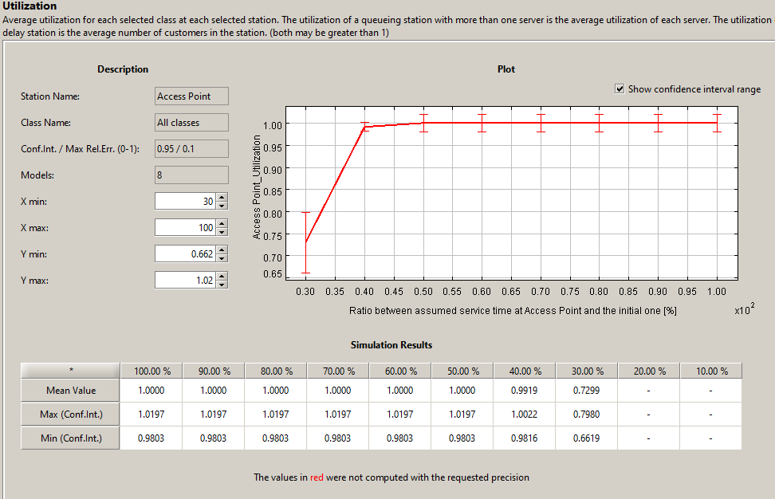
What-If Simulation (Service time AP)

Slide 46


What-If Simulation (Service time AP)
The AP is the bottleneck thus we decide to Improve the performances reducing the service time up to 10% of its original value for the open classes. As we can see, the Queueing time, Utilization and Residence time of the AP drops as expected. While the System response time raises and throughput decreases. At this point, there is a new bottleneck that is the only 1 Railway Server which is no longer capable of handling the extra traffic coming from the AP.

Slide 47





What-If Simulation (Service time AP)
We redo the What-If analysis of the AP using this time 10 Railway Servers instead of 1.
As we can see, the Queueing time, Utilization and Residence time of the AP drops as expected. Moreover, we see that the System response time decreases and throughput keep increasing. So we have greatly improved our system.

Slide 48



What-if Simulation(Arrival Rates 3)
We redo the What-If analysis of the Passengers open model arrival rates which are incremented from 100% to 300% in 10 steps with 10 Railway Servers

Slide 49



What-if Simulation(Arrival Rates 4)
As we can see the system drop rate keep increasing mainly due to the AP which is overfloaded by the growing arrival rate. So in this case the bottleneck is still the AP and thus improving to 10 the number of Railway Server doesn’t introduce any significant advantage.

Slide 50
Conclusions
In conclusion, we found that the AP is the bottleneck thus through the What-If analysis in an iterative way we managed to achieve better performances, first in the AP reducing the service time. Then, improving the Railway Server to cope with the system response time and throughput.
A sudden increment of heavy requests to external servers (Class 2 requests) does not affect the global performance, although the probability of being rejected by the AP is way higher.
Actually 3G (UMTS, HSPA) technologies installed on Italian’s high speed trains can barely satisfy user needs, in particular considering that the percentage of passengers using portal services is low. Enormous steps forward had been made in providing more external routers and servers along Italian railways (specially into galleries), anyway it’s evident, also from our simple model, that an upgrade in AP technology is required more than other services. The «management» system used by staff and sensors, on the other way, works fine and is affected only by problems that emerge when we consider the high speed and electromagnetic effects such as Doppler Effect. Anyway, this is not the topic of the course and we’ll not enter this field for following analysis.

Slide 51
Contacts-Questions?
Carminati Fabio, mat. 919803
fabio3.carminati@mail.polimi.it
Gallone Emanuele, mat. 914114
emanuele.gallone@mail.polimi.it

